Slide 1
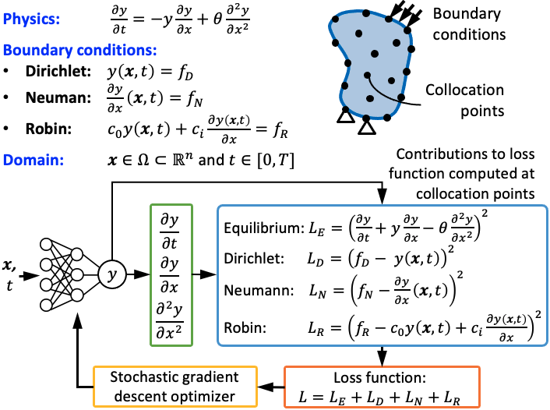
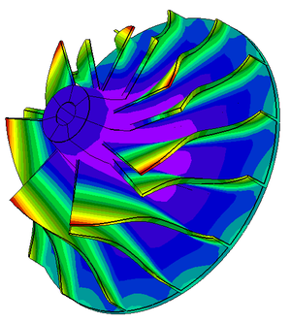
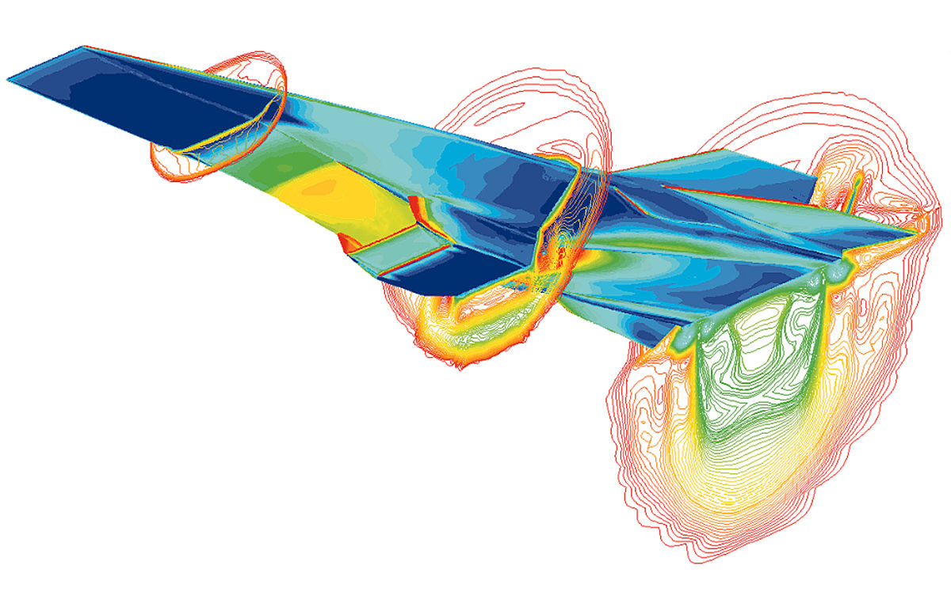
PINN 101
Computational mechanics
Finite element modeling
Computational fluid dynamics
Physics-informed neural networks

Slide 2
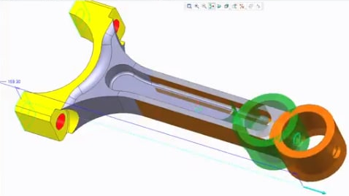
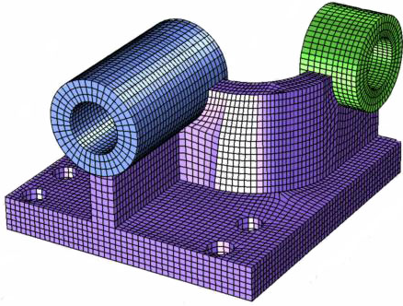
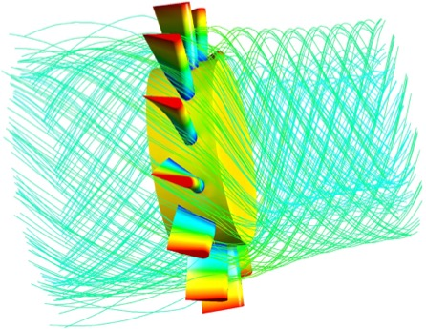

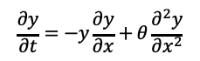
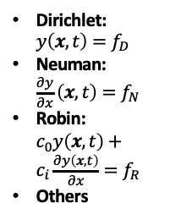
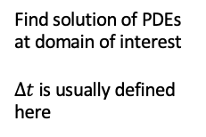
From geometry to visualization of results
Third party
Potential interface with other packages
Bulk of parallelization
Computational mechanics
1) Geometry
2) Mesh
3) Governing equations
4) Material formulation
5) Boundary conditions
6) Solver
7) Post-processing
PDEs:
Fluid dynamics
Heat transfer
Elasticity
Material properties
Constants
Varying properties
Temperatures, pressures, forces, displacements, etc.
Find solution of PDEs at domain of interest
$Δt$ is usually defined here
3D modeling (primitives, transformations, parametrization, etc.)
Mesh geometrical model or import it from a different application.
“PINN jargon”
Train PINN model
Pick NN architecture
Define loss function
Run optimizer
Predictions with trained PINN model
Dirichlet: $y\left(x,t\right)=f_{D}$
Neuman: $\frac{∂y}{∂x}\left(x,t\right)=f_{N}$
Robin: $c_{0}y\left(x,t\right)+c_{i}\frac{∂y\left(x,t\right)}{∂x}=f_{R}$
Others
Sample domain (space)
$$\frac{∂y}{∂t}=−y\frac{∂y}{∂x}+θ\frac{∂^{2}y}{∂x^{2}}$$
Model for $θ$
Our project
AWS-UCF-PINN:
FreeCAD
Alternatives:
Fusion360, Inventor, SolidEdge, etc.
AWS-UCF-PINN:
FreeCAD / Gmesh / Vedo / PyVista
Alternatives:
Most FEA or CFD packages offer it
AWS-UCF-PINN:
We will design a metafile system (similar to scripts used by other computational mechanics packages).
This is where libraries such as Vedo / PyVista will be used
Training vs prediction as well as solver configurations can be defined through a file system
AWS-UCF-PINN: Generate results compatible with ParaView
Alternatives:
Most FEA or CFD packages offer it

Slide 3
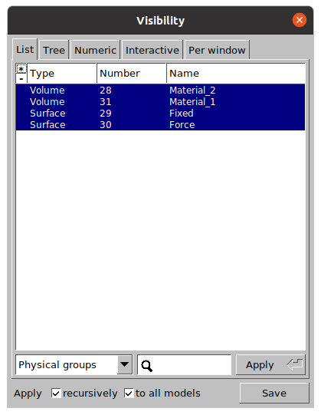
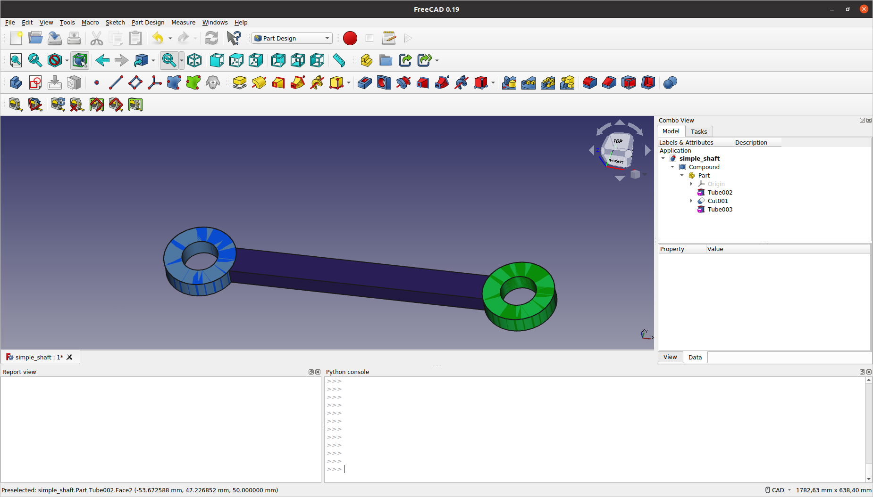
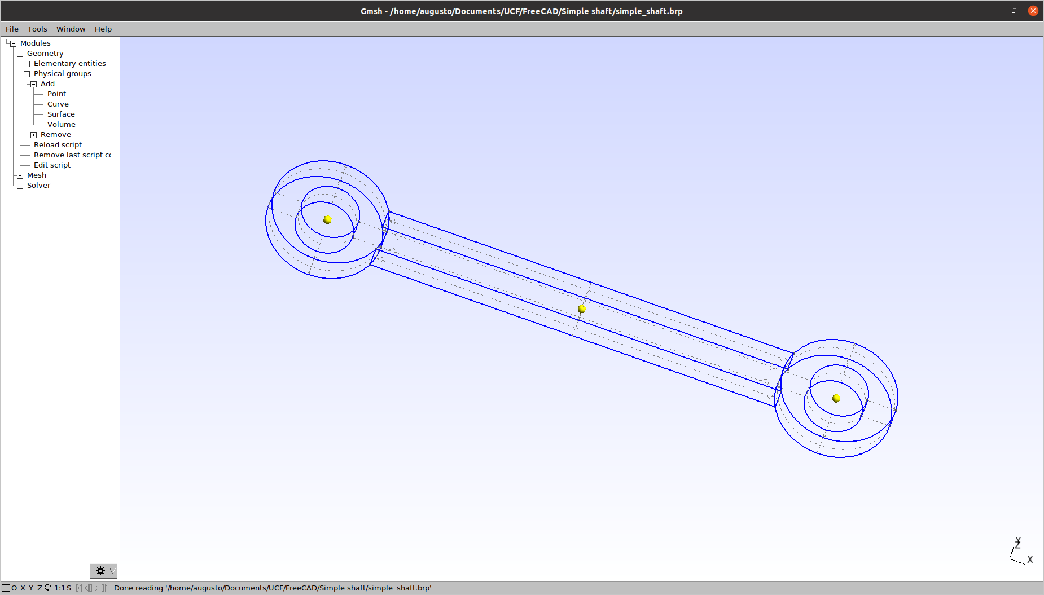
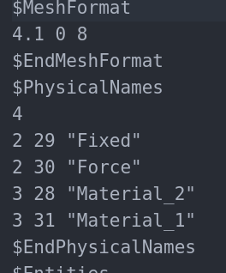
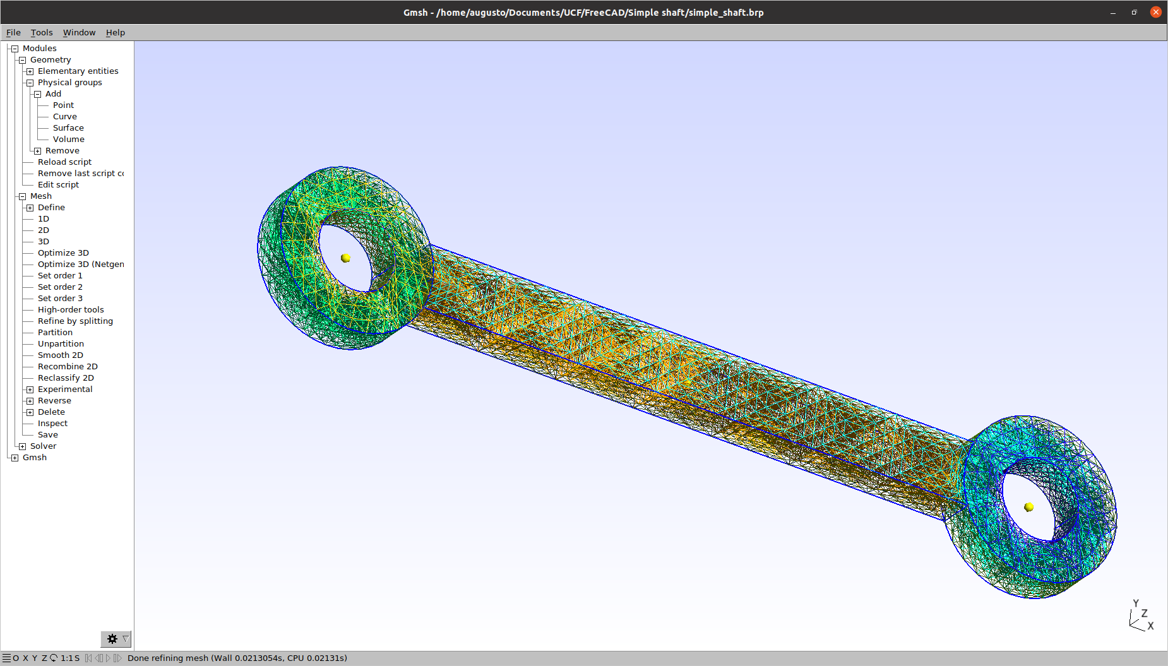
Leveraging engineering design tools
1
FreeCAD for drawing
2
Gmesh for annotation
3
Annotaded *.msh file

Slide 4
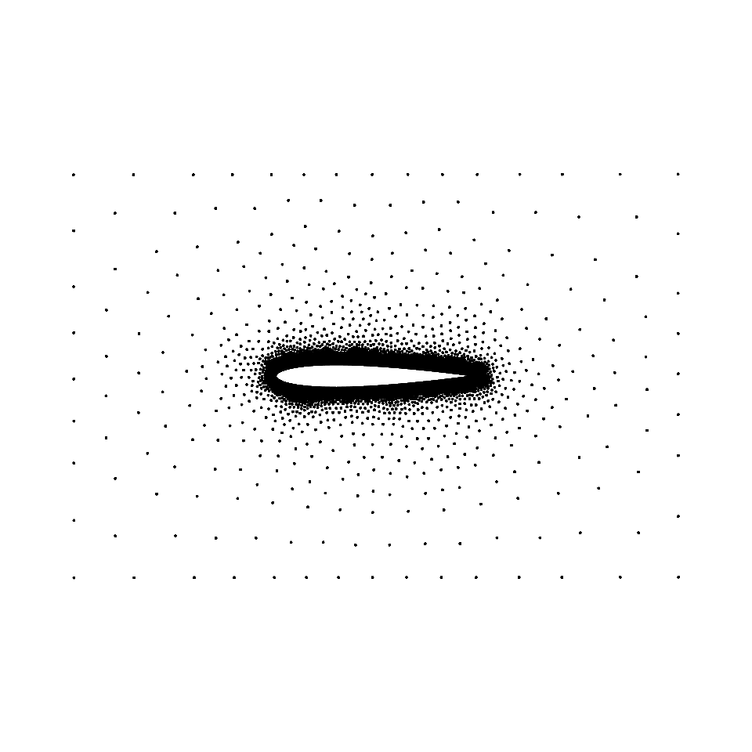
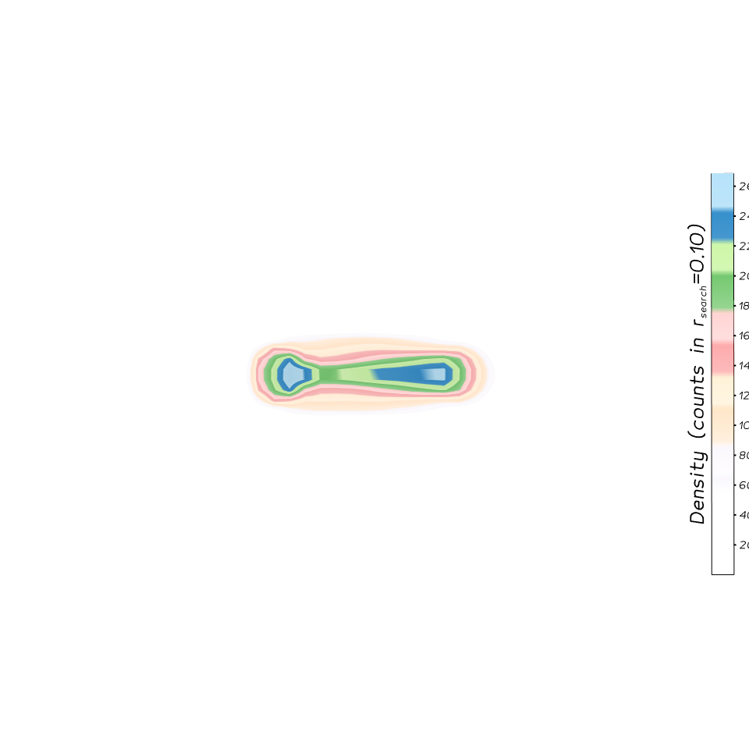
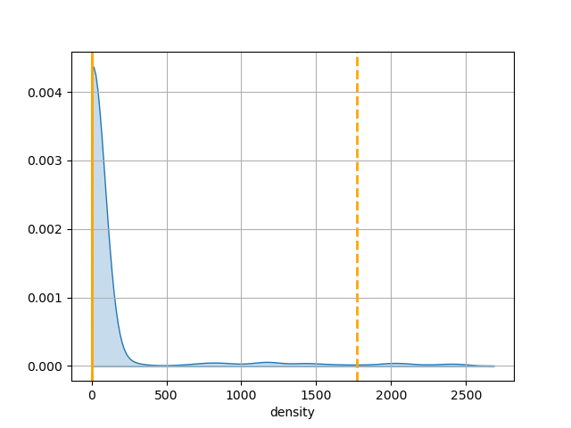
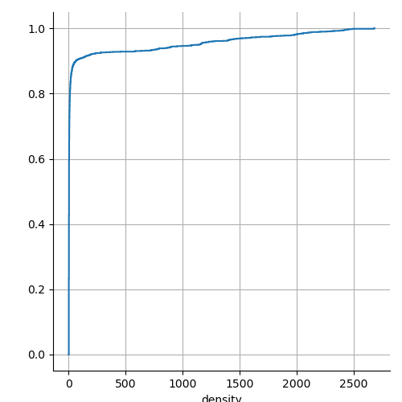
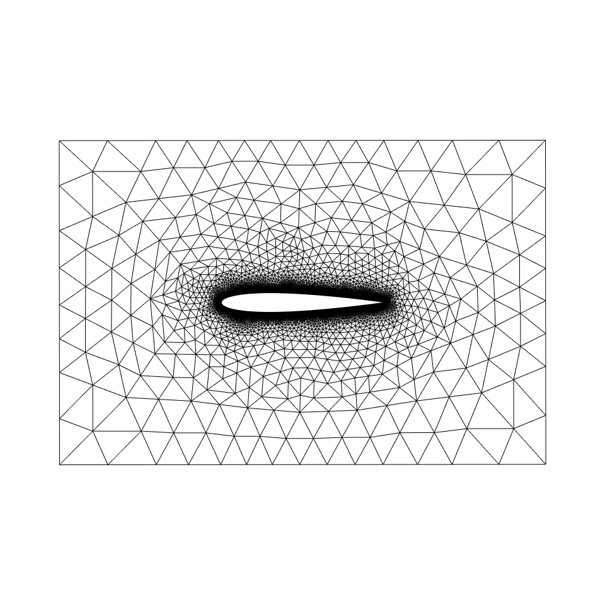
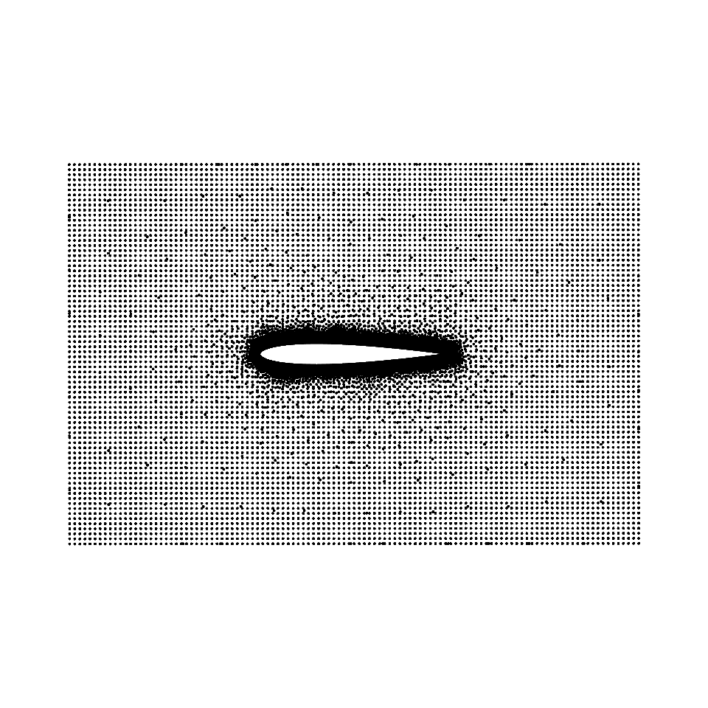

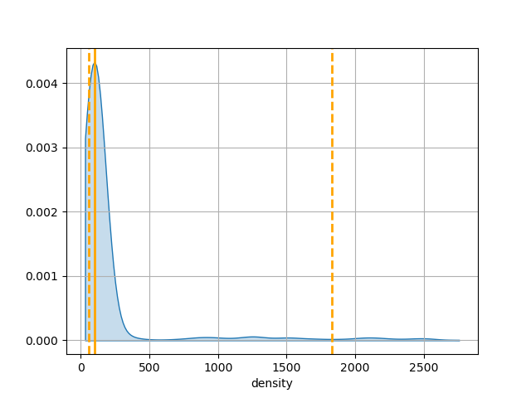
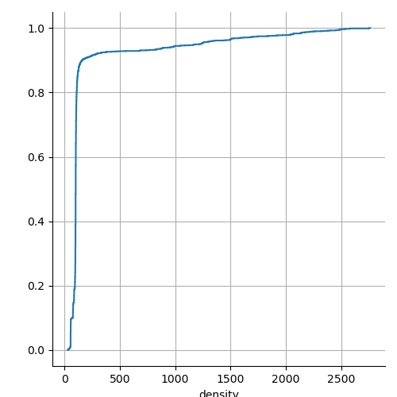


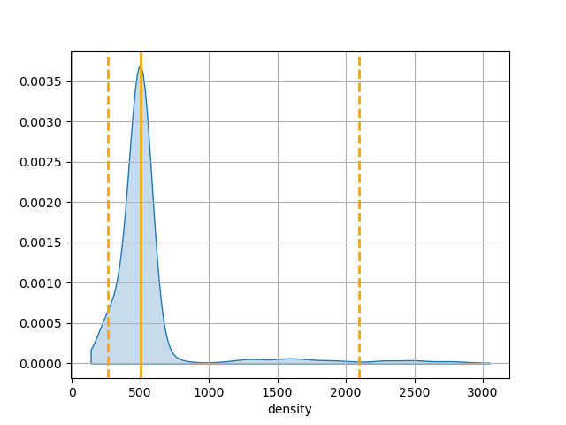
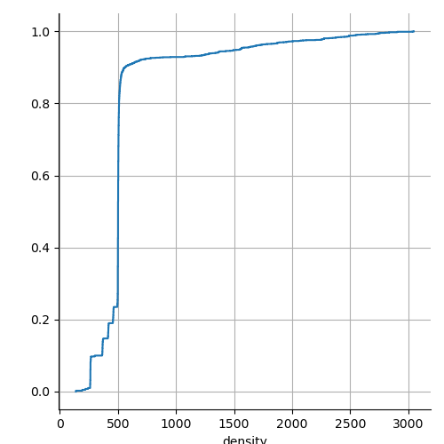
Densification of collocation points
colocation points
density
density dist.
ecdf
original
initial mesh
75% percentile
500 pts/voxel

Slide 5
DDP Solver

Slide 6
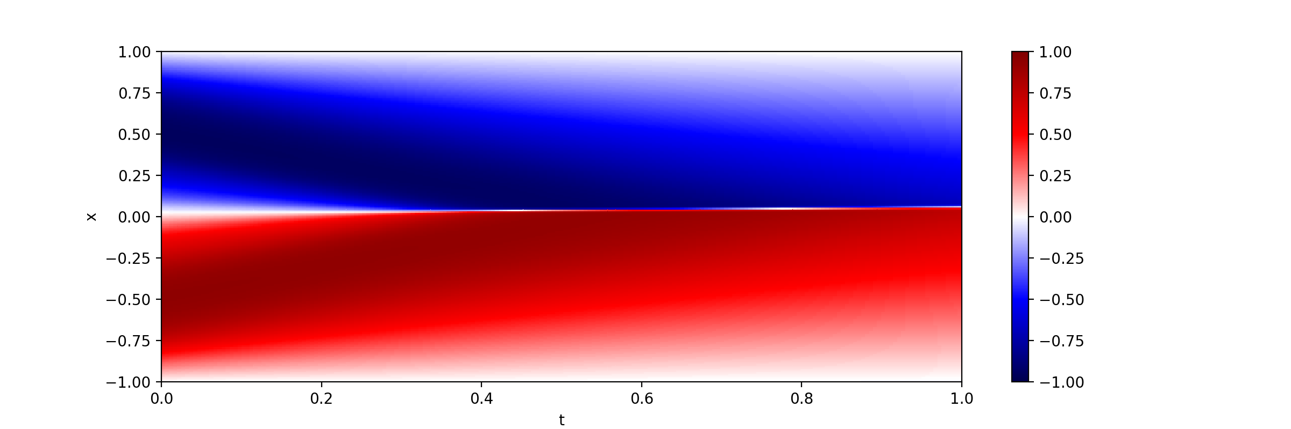
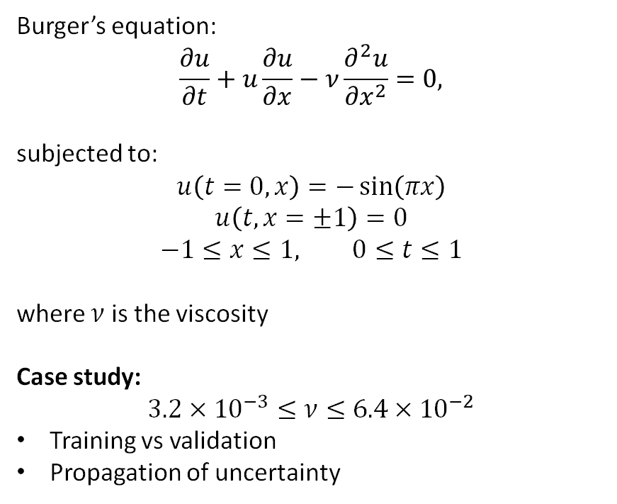
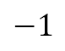
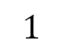
Parametric modeling
Burger’s equation:
$$\frac{∂u}{∂t}+u\frac{∂u}{∂x}−ν\frac{∂^{2}u}{∂x^{2}}=0,$$
subjected to:
$$u\left(t=0,x\right)=−\sin\left(πx\right)$$
$$u\left(t,x=±1\right)=0$$
$$−1≤x≤1, 0≤t≤1$$
where $ν$ is the viscosity
Case study:
$$3.2×{10}^{−3}≤ν≤6.4×{10}^{−2}$$
Training vs validation
Propagation of uncertainty
$$1$$
$$−1$$

Slide 7
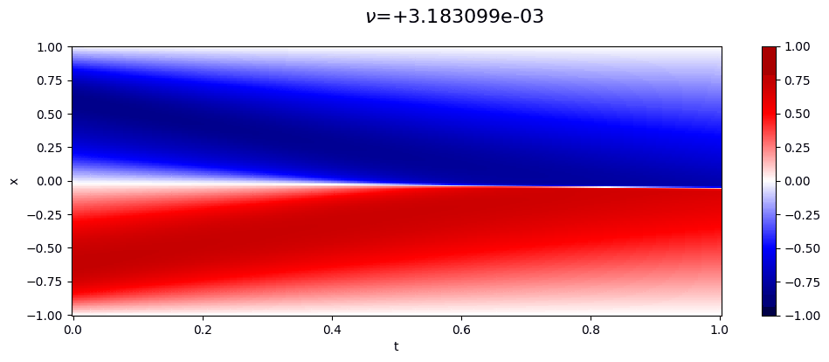

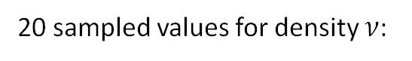
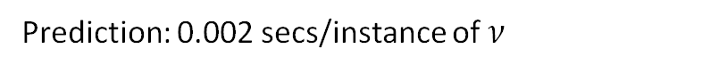
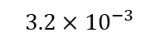
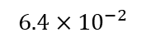
Training
10,000 collocation points (from grid):
Boundary conditions
Initial conditions
1
x
-1
0
t
1
20 sampled values for density $ν$:
10
$$3.2×{10}^{−3}$$
$$6.4×{10}^{−2}$$
Prediction: 0.002 secs/instance of $ν$
Training:
10,000 epochs
4 hours (investigating issue, maybe installation)

Slide 8
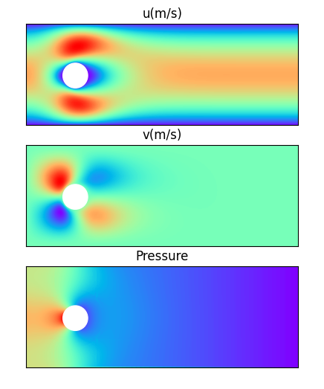
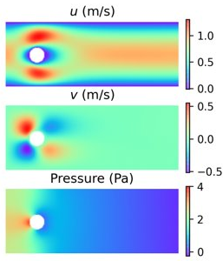
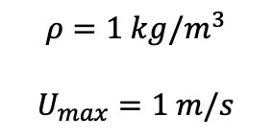
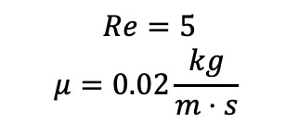
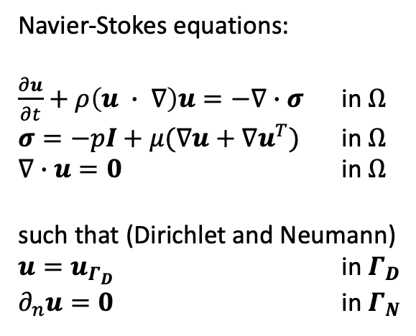
Laminar flow
(a) OpenFOAM
(b) Our results
Navier-Stokes equations:
$\frac{∂u}{∂t}+ρ\left(u ∙ ∇\right)u=−∇∙σ$ in $Ω$
$σ=−pI+μ(∇u+∇u^{T})$ in $Ω$
$∇∙u=0$ in $Ω$
such that (Dirichlet and Neumann)
$u=u_{Γ_{D}}$ in $Γ_{D}$
$∂_{n}u=0$ in $Γ_{N}$
$$Re=5$$
$$μ=0.02\frac{kg}{m⋅s}$$
$$ρ=1 kg/m^{3}$$
$$U_{max}=1 m/s$$

Slide 9
Summary and future work
Major milestones achieved:
Leveraged engineering tools to handle geometry to collocation points
Designed and prototyped DDP solver
Results with academic problems
Current and future work:
Strategy for large datasets (needed for parametric models)
Improved training of neural network
Domain decomposition
Warm-start
Schedulers
…
Expand use cases to other engineering problems

Slide 11
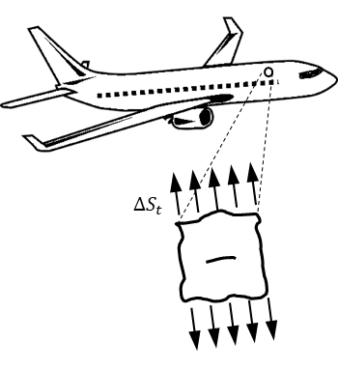
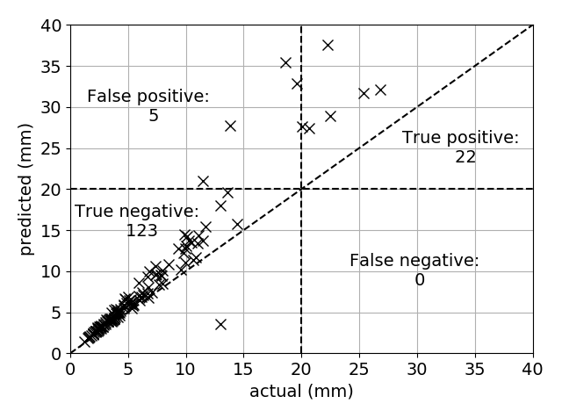
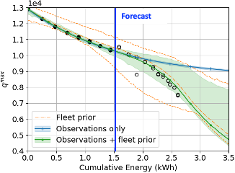
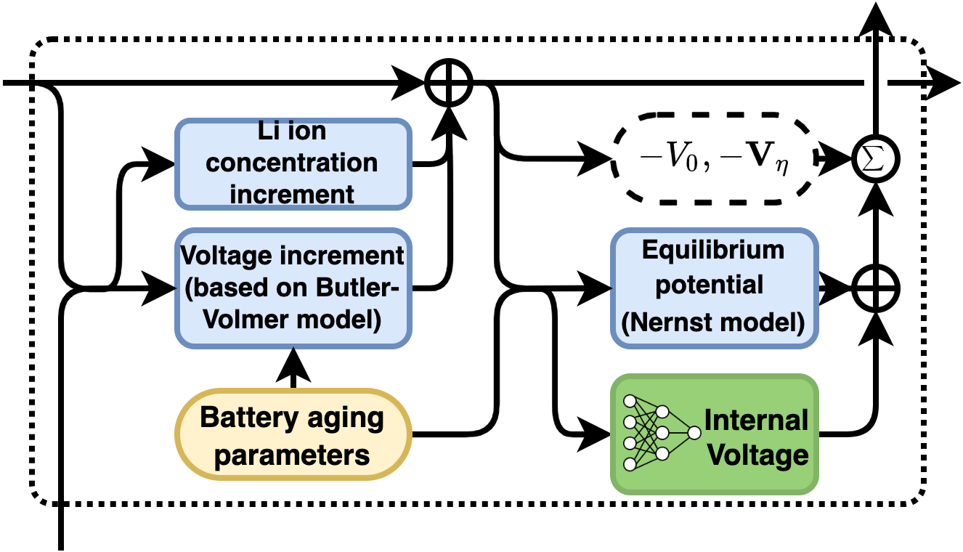
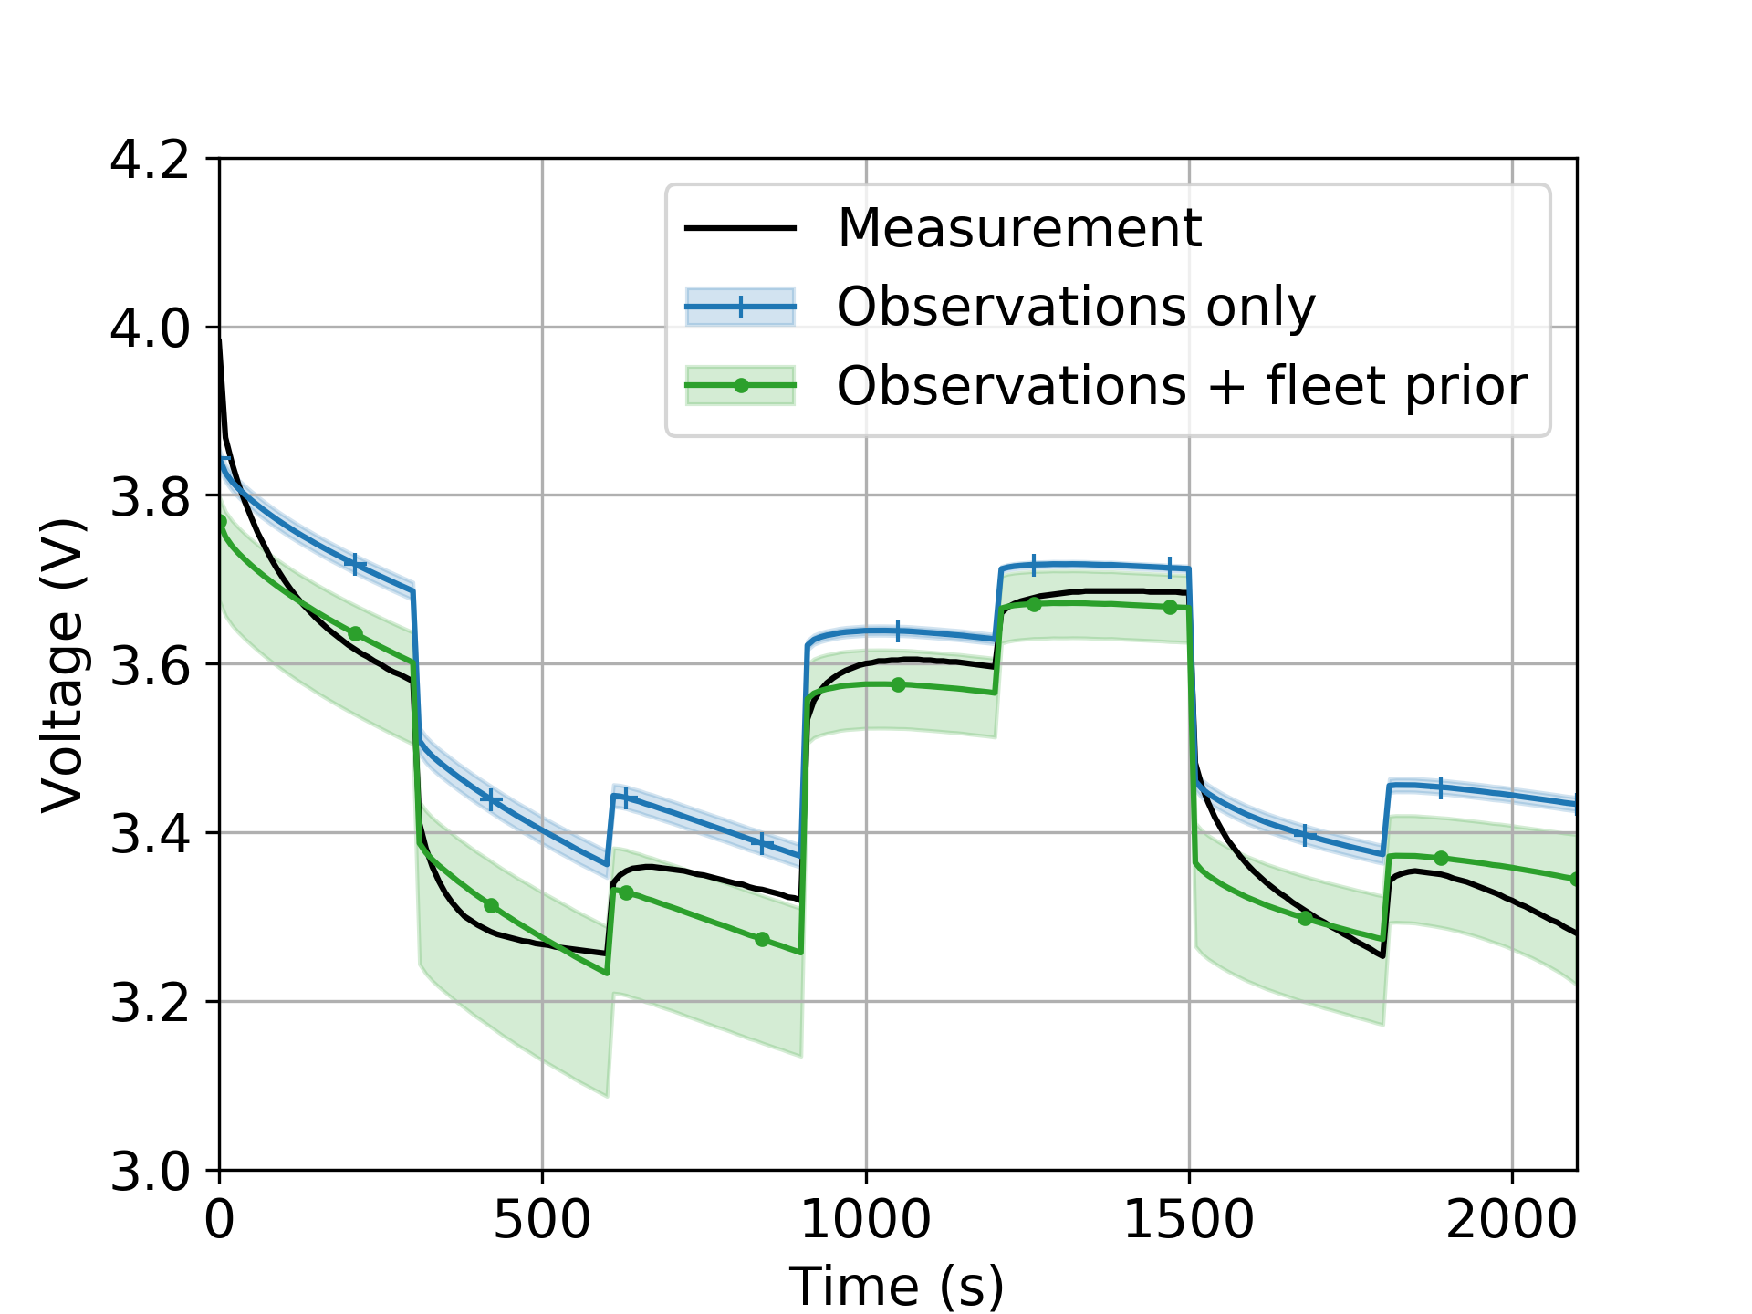
Hybrid models for uncertainty quantification
Proof-of-concept
Corrosion-fatigue cumulative damage in aircraft wing panels
Fleet: 300 airplanes
Inspection: 15 airplanes
R. G. Nascimento and F. A. C. Viana, "Cumulative damage modeling with recurrent neural networks," AIAA Journal, Vol. 58 (12), pp. 5459-5471, 2020.
A. Dourado and F. A. C. Viana, "Physics-informed neural networks for missing physics estimation in cumulative damage models: a case study in corrosion fatigue," Journal of Computing and Information Science in Engineering, Vol. 20 (6), 2020.
Grease effect in wind turbine main bearing fatigue
Li-ion battery prognosis
Y. A. Yucesan and F. A. C. Viana, "Hybrid physics-informed neural networks for main bearing fatigue prognosis with visual grease inspection," Computers in Industry, Vol. 125, pp. 103386, 2021
R. G. Nascimento, M. Corbetta, C. S. Kulkarni, and F. A. C. Viana, "Hybrid physics-informed neural networks for lithium-ion battery modeling and prognosis," Journal of Power Sources, Vol. 513, pp. 230526, 2021.

Slide 12
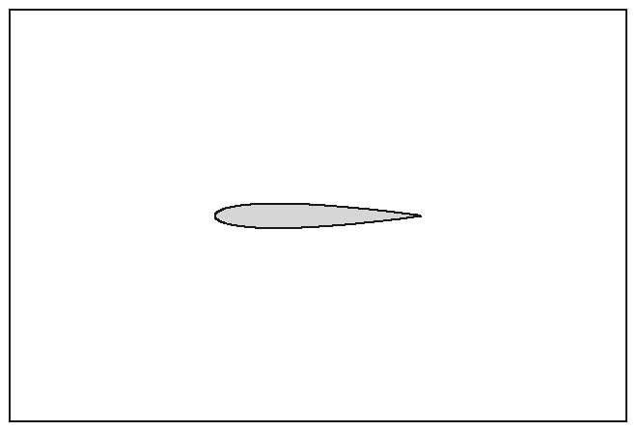
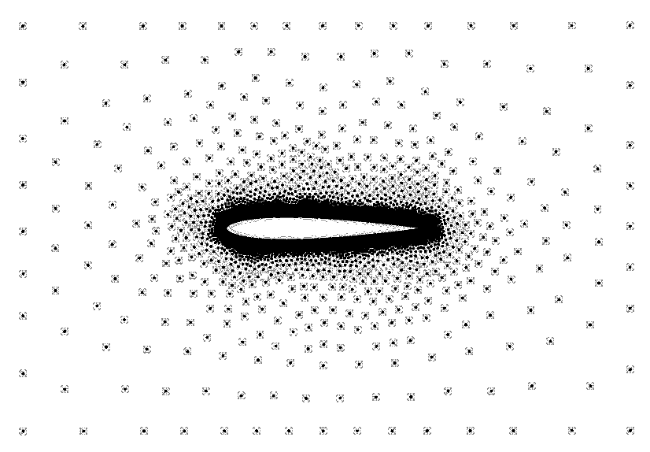
Proposed PINN workflow
Third party
1) Generate geometry
Potential interface with other packages
Observations:
Generate geometry: we use FreeCAD, but in the future, other options can be considered
Generate baseline mesh:
GMsh for now
Mesh defines problem through annotation
Annotation uses engineering jargon (inlet, no slip, outlet, etc.) as opposed to math jargon (Dirichlet, Neuman, etc.)
Generate collocation points: densify if needed.
Customize Python: this is where user can define parametrization of boundary conditions and geometry for example.
Generate solver files: training and prediction specs (loss, data partitioner scheme, number of GPUs, etc.)
Bulk of parallelization
2. Annotate equilibrium, BC, and material and generate baseline mesh
from mesh
densified
3) Generate file with collocation points
4) Customize (template) Python code for equilibrium, BC, and material
5) Generate solver setup files
6) Run solver

Slide 13
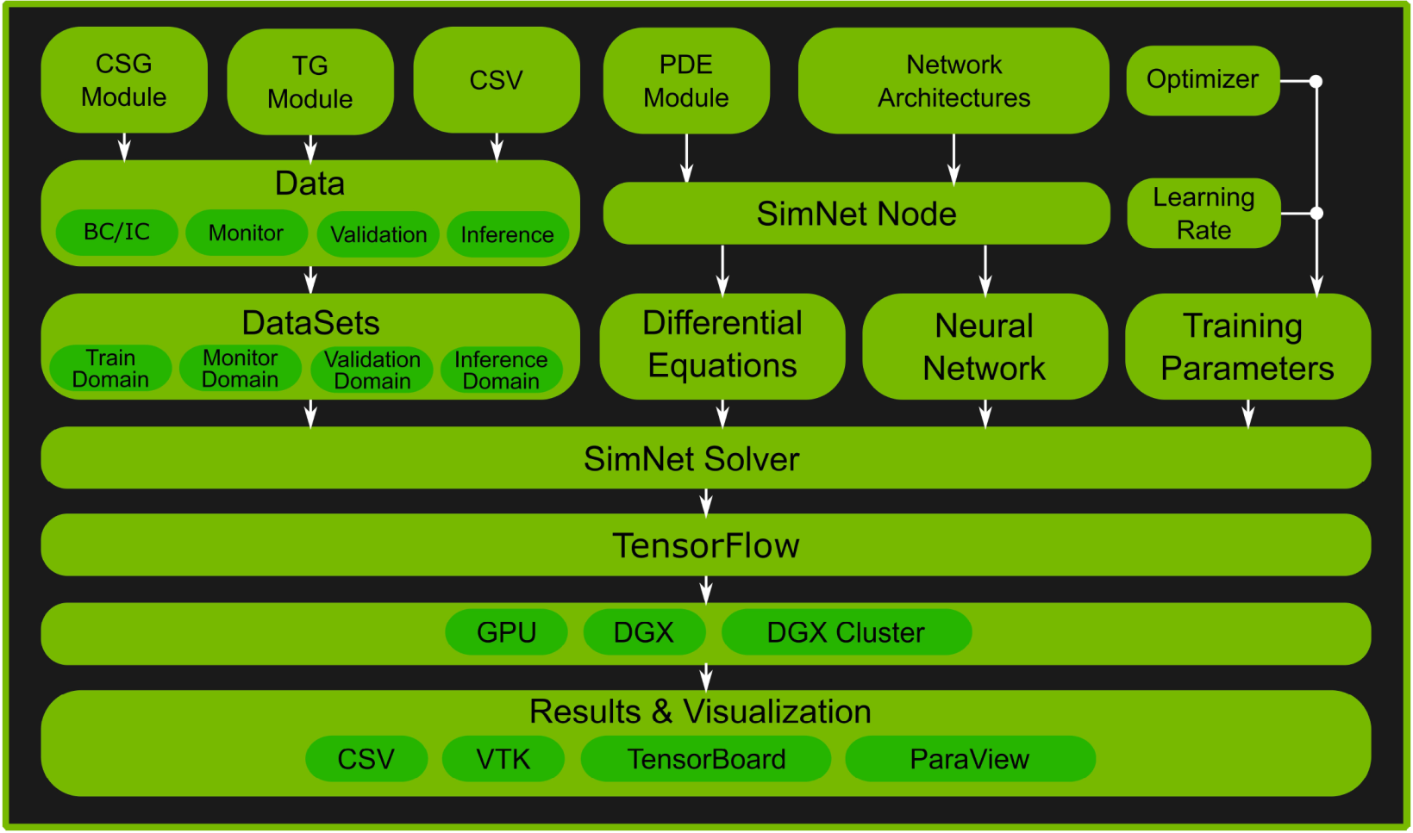
Designing and implementing our PINN package
Modeling elements
SOTA Architecture: Modulus (former SimNet)
Geometry
STL files
Point cloud
First principles
Partial differential equations
Boundary conditions
Initial conditions
Solver
As we implement the geometry modules, we will design our architecture with scalability in mind

Slide 14
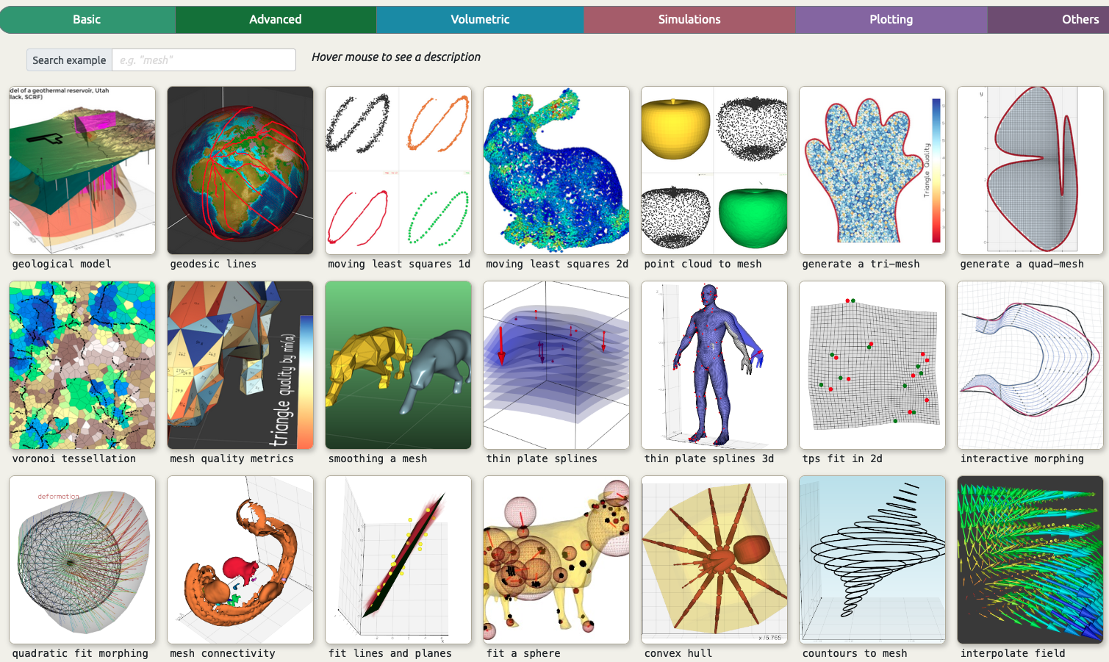
Vedo: an alternative solution under consideration
https://vedo.embl.es/#gallery​ https://github.com/marcomusy/vedo​

Slide 15
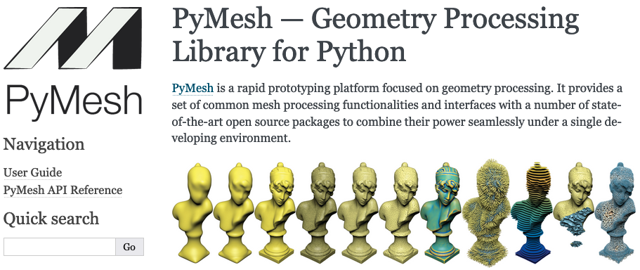
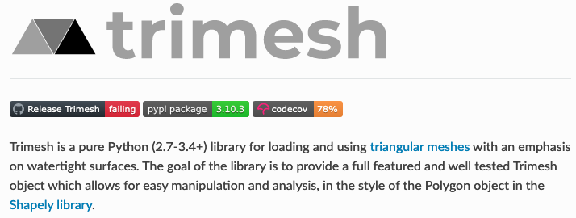
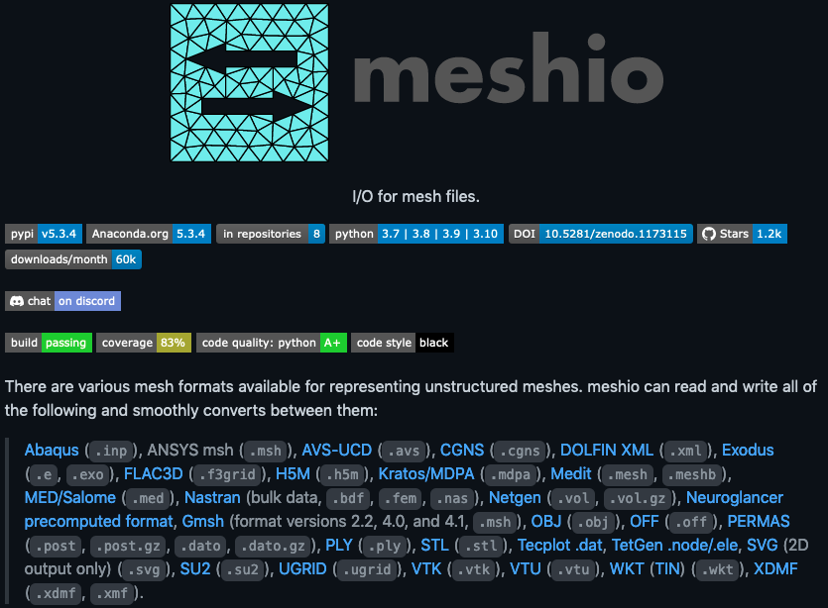

Other Python libraries
https://pymesh.readthedocs.io
https://trimsh.org/index.html
https://github.com/nschloe/meshio
https://docs.pyvista.org

